Slide 1
Team 3 Final Project Jun Lee: Back-end, scrum master Peter Broadbent: Front-end, motivator Saad Ahmed: Back-end, expert tutor Ladislav Mudry: Front-end, documentation

Slide 2
Introduction
MVP: Full Stack Cinema Website
Components
REACT, Express, Node, Mongoose
Scope
Feature-branch model, Jira project management board, Risk assessment

Slide 3
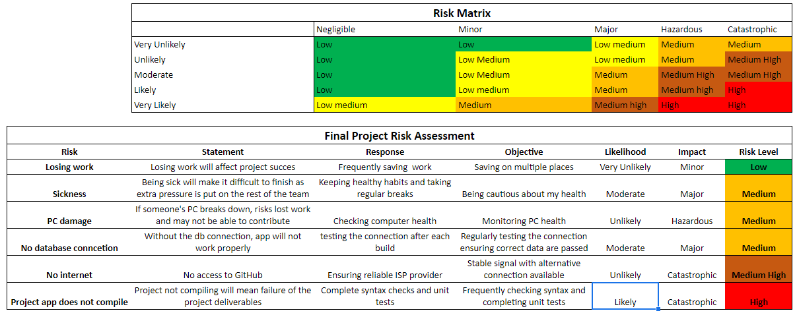
Risk Assessment

Slide 4
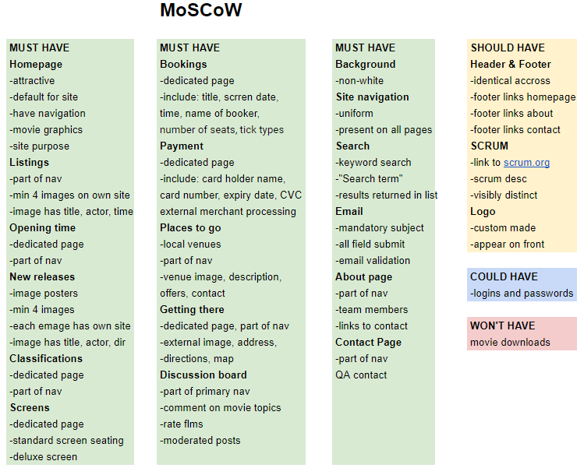
MoSCoW

Slide 5
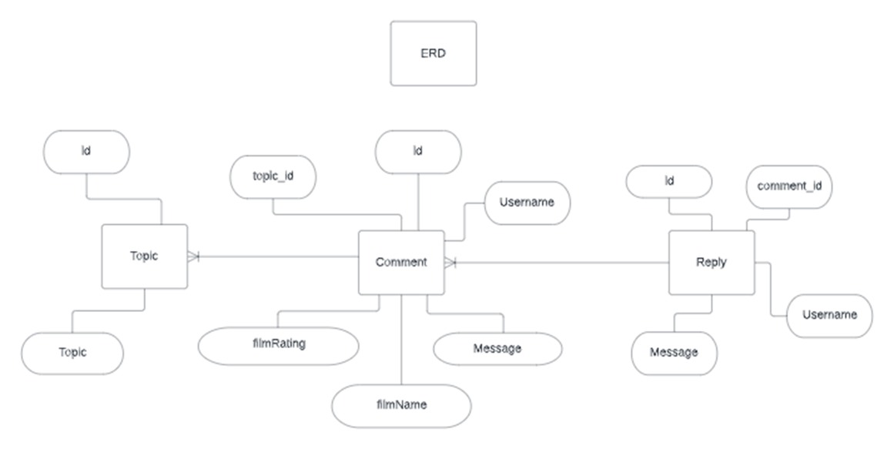
ERD

Slide 6
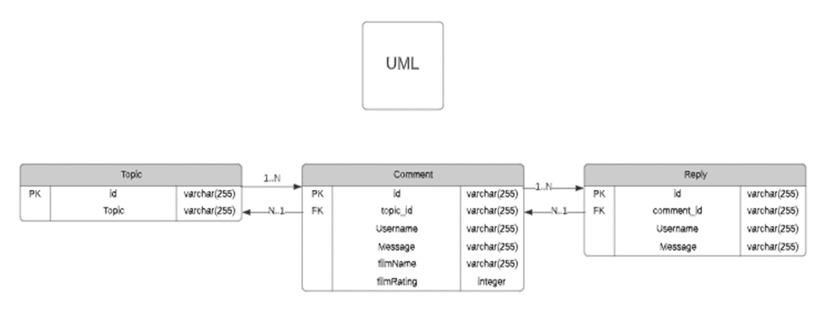
UML

Slide 7



Sprints
2 SPRINTS
18 EPICS
Over 100 user stories

Slide 8


Jira Board

Slide 9

Let’s take a look..
Git Version Control

Slide 10
Testing
_{What we didn’t manage to test}
What we managed to test

Slide 11



Test Coverage
How much test coverage achieved?
Industry standard is 80%

Slide 12
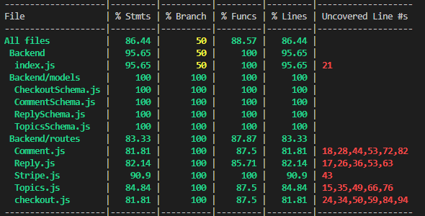
Test Results

Slide 13
Sprint 1 Review
What went well
What didn’t go well
What goals took too long
What goals were missed

Slide 14
Sprint 2 Review
What went well
What didn’t go well
What goals took too long
What goals were missed

Slide 15

Live Demo

Slide 16
Our Developer Journey
Skills needed for project:
- REACT, Express, Node, Mongoose, Mocha, Pair programming
What have we learned? - A lot!
How it has allowed us to complete project

Slide 17

Thanks for listening!
Questions?

